Slide 1
MODEL DEVELOPMENT ON WHETHER A PERSON IS DIAGNOSED
WITH HEART DISEASE OR NOT
GROUP MEMBERS-
“ANWESH BISWAS” “ID No: TU2F1920039”-EXTC/SEM5
“NABEELA MALLICK” “ID No: TU2F1920040”-EXTC/SEM5
“ KAUSTUBH LANGADE” “ID No: TUS3F181924”-CS/SEM5

Slide 2
INTRODUCTION
The objective of this project is to develop a model & determine what variables can are required to conclude that whether a person is diagnosed with heart disease or not.

Slide 3
NEED
It is observed that most of the people in the age bracket of mid-30’s to mid-70’s suffering from heart disease and this is because of their unhealthy and unhygienic lifestyle moreover people in their age bracket do several kinds of test but don’t know what practically range of blood pressure, ECG, heartbeat, cholesterol, gastric problems they should fall in or follow to stay fit and fine. In this project, we have analyzed and figured out what are the range and order plus how to determine whether the person is diagnosed with heart disease or not
There are lot many reasons/factors which depends on the final decision that concludes that the patient is suffering/has suffered from heart disease
Factors such as age, sex,chest pain, blood pressure, ECG, heart rate, and other related values are required for the detailed analysis

Slide 4
FEATURES
Filtered data/processed data can be visualized with the help of matplotlib & seaborn packages and with the help of sklearn we can train the entire data model after which when MACHINE LEARNING algorithms are applied it gives us various accuracy upon comparison it is found that logistic regression holds the highest accuracy

Slide 5
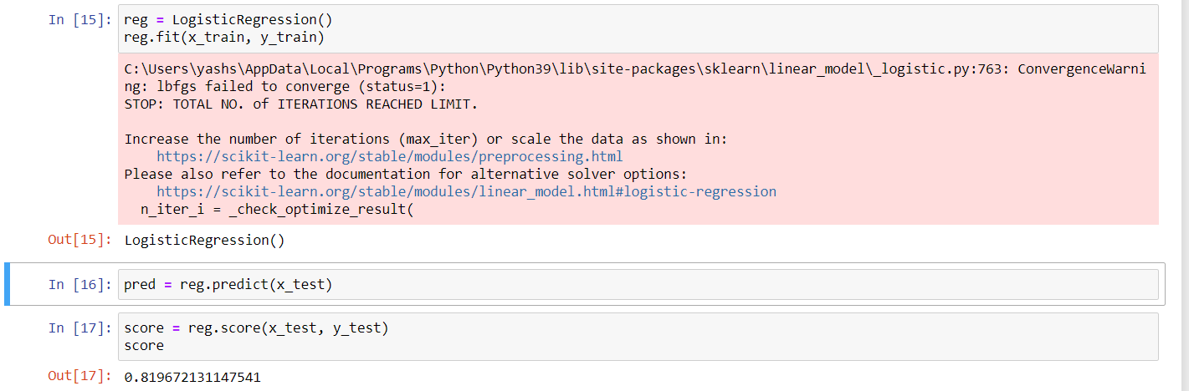
Classification Algorithms Chosen:
Logistic Regression(LR)
Accuracy Found-81.96%

Slide 6
Working of Algorithms:
First, we converted all the data set columns to a list to get an overview of the data we had on our hands.
We first checked for null values. All the null values in the dataset were in the salary column and after a quick glance at the data set we found that the null values were only for those students who didn’t get placed. So, we filled all the non-available' values as 0 and after rechecking for null values and not finding any, we moved on.
Lastly we checked for any columns/features that could be dropped, and decidedto drop the not required feature relevant and thus dropped them.

Slide 7
Data Visualisation:
Let’s first see what Data visualization is -:
Data visualization is the graphic representation of data.It involves producing images that communicate relationships among the represented data to viewers of the images.
We plotted all relevant columns in various types of graphs and plots to get a nice visual representation of our data set.

Slide 8
Assigning Variables and Setting Train/Test Ratio:
Keeping in mind the questions we chose to answer with this dataset, we assigned a set of variables as Independent variables and put them in a list and put the dependent variable in another list.
Dependent Variable - Status of placement
Independent Variables - Everything else that remained.
After this, we set the Train/Test to a 0.75/0.25 split and proceeded with our chosen models.

Slide 9
HERE WE GO WITH THE
MACHINE LEARNING MODELS

Slide 10
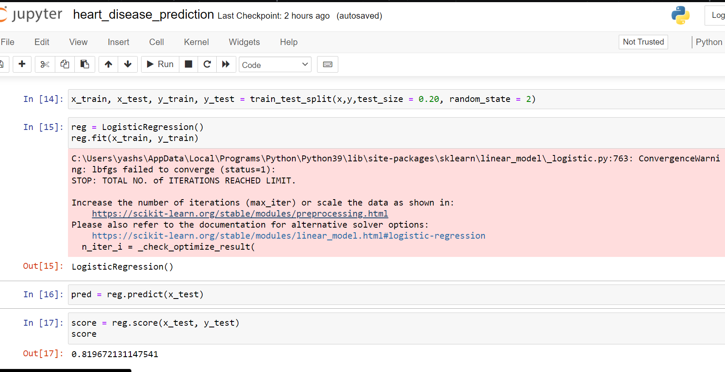
Logistic Regression:
For this model, we simply imported the concerned module from the sklearn package and passed our data set to the concerned function from said module.
The team then generated a confusion matrix and a classification report using more functions from the sklearn package (metrics module). An accuracy percentage was also calculated using similar methods.

Slide 11
Analysis & Learning
A basic logistic regression model fitting with one variable
Understanding odds and log-odds with examples
Logistic regression model fitting with two variables
Logistic regression model fitting with three variables
Visualization of the fitted model
Prediction

Slide 12
Reference
CSV DATASET :Provided by KSI
Name:Heartdisease.csv
Guidelines:Word document provided by KSI

Slide 13

.

